Slide 1
Last class: Where to find experimental protein structures and how to view them
Today:
What if there’s no experimental structure of my protein?
What kinds of analyses can I do on my protein structure or model?
But before we start, choose your protein sequence of interest and model it in:
https://swissmodel.expasy.org/ (SM)
https://github.com/sokrypton/ColabFold (AF2)
√ Leave the tabs open. √ In the Colabfold select save_to_google_drive.
We’ll come back to this later!

Slide 2
1) Modeling proteins of unknown structure 2) What to look at in protein sequences and 3D models? Global aim: Getting started to understand your new protein → Goal of models: low-res experiments, design constructs for experiments, explain biology, etc.
CLASS 2
https://go.epfl.ch/bio-643

Slide 3
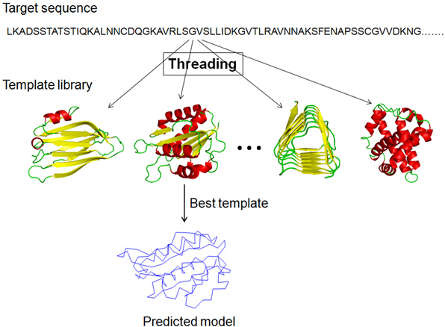
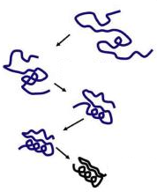
Modeling proteins of unknown structure
Homology modeling
Template-less (“ab initio”) prediction
Template detection
CASP
Critical Assessment of Structure Prediction
Dedicated issues in Proteins: Structure, Function and Bioinformatics
Threading
Physics- or Data- based conformational potential
Sampling capacity
Scoring to detect folded structure
External data? (experiments, coevolution, etc.)
Contact predictions
AlphaFold(2) / RoseTTAFold
Find structurally similar template in PDB
Align sequences as well as possible
Thread target onto template
Refine loops and poorly aligned regions
(C-)I-TASSER, Ros(b)etta, RaptorX, SwissModel
CASP refs: See dedicated issues in Proteins: Structure, Function and Bioinformatics

Slide 4
CASP
Since 1994
CASP in a nutshell
New structures CASP organizers Assessors
Predictors
Reads from my involvement as assessor of tertiary structure predictions:
3 x Proteins 2018 (CASP12) 1 x Proteins 2019 (CASP13)
1 x Bioinformatics 2020 (general) 1 x Briefings in Bioinformatics 2020 (practical as for CASP13)
Notes:
So what we do in CASP is to evaluate all models for each EU. This evaluation is mainly visual but guided by scores, and we group very similar models into clusters. One contribution from our group to CASP is a web app that we can use to easily navigate models and compare them to the targets in a single interface. Moreover, once the evaluation is done we can open this to the world such that then when you read our paper you can follow each thing we describe directly here online. Let me show you quickly how this works… T0955D1

Slide 5
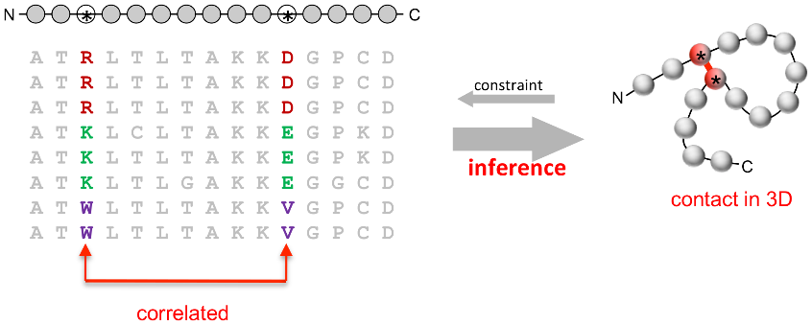
Progress in modeling very hard targets?
Machine Learning for molecular modeling
Coevolution-based contact prediction methods in literature
(1994)
(2018)
http://labriataphd.altervista.org/
Abriata, Tamo, Dal Peraro, Proteins 2019 (official CASP13 assessment)
https://onlinelibrary.wiley.com/doi/10.1002/prot.25787

Slide 6
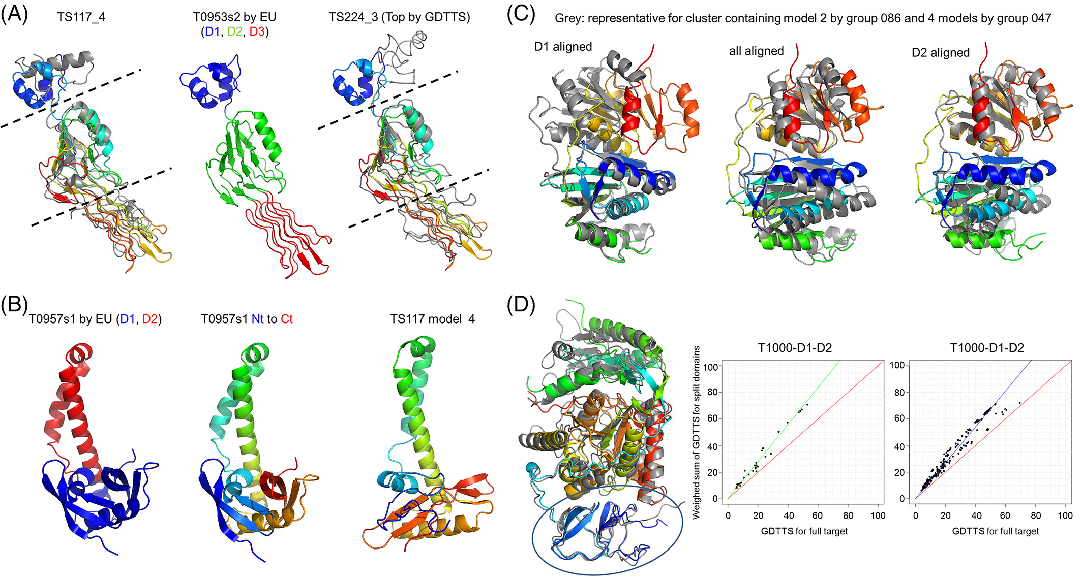
From CASP13 even some FULL PROTEINS are modeled ok (before, only domains were)
Abriata, Tamo, Dal Peraro, Proteins 2019 (official CASP13 assessment)
https://onlinelibrary.wiley.com/doi/10.1002/prot.25787

Slide 7
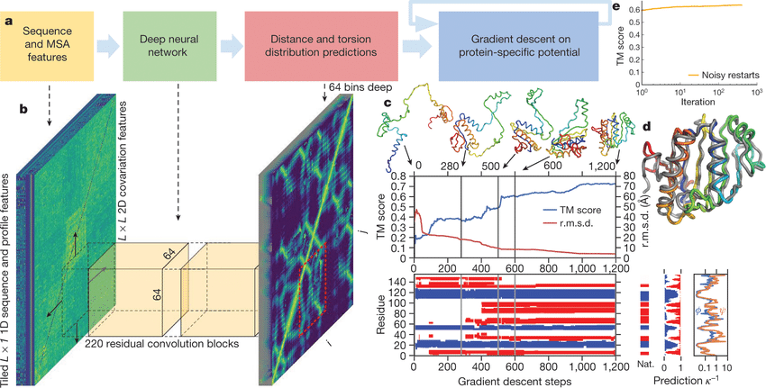
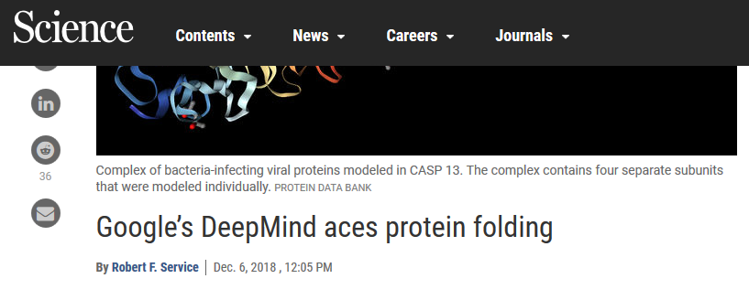
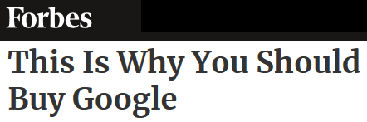
Machine learning for Protein structure (mostly tertiary even in AlphaFold 2,
but going after quaternary)
Sequence
Features
Predictions
Folding
Alignments
Coevolution
Template search
Threading
Contacts, distances and orientations from PDB structures
Wang et al PLoS Comp Biol 2017
Kandathil et al Proteins 2019
Hou et al Proteins 2019
Xu PNAS 2020
Senior et al Nature 2020
Yang et al PNAS 2020
AF 1 is in this category of methods, but they pushed it to the limit.
Anyway most of the hype was just marketing

Slide 8
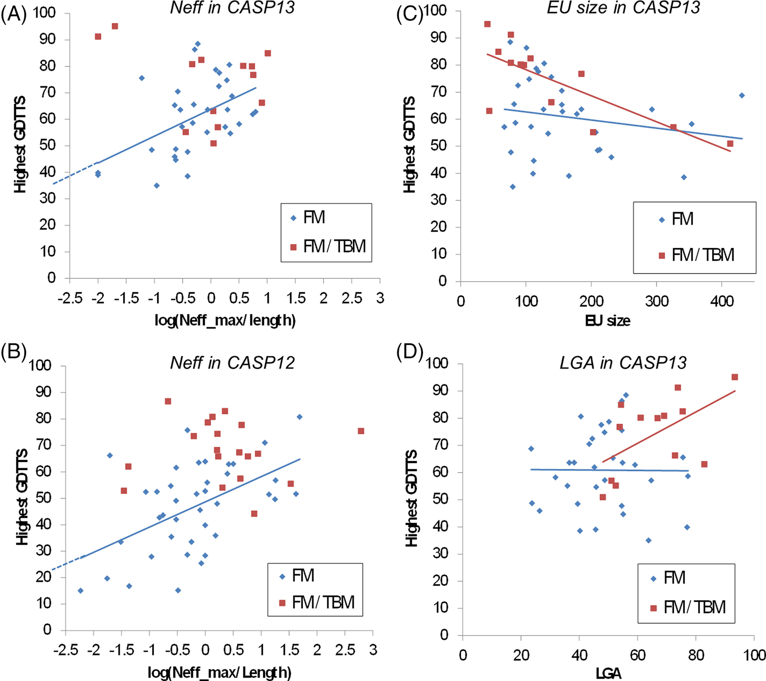
Limitations as of CASP13 ?
-3ry structure of domains,
little or no quaternary structure
-side chains not evaluated
-Nets may be ”recalling” structures
-Alignment depths: coevolution
data quite essential
Spoiler alert valid as of 2024: None fully overcome by CASP15 / AlphaFold 2
Abriata, Tamo, Dal Peraro, Proteins 2019 (official CASP13 assessment)
https://onlinelibrary.wiley.com/doi/10.1002/prot.25787

Slide 9
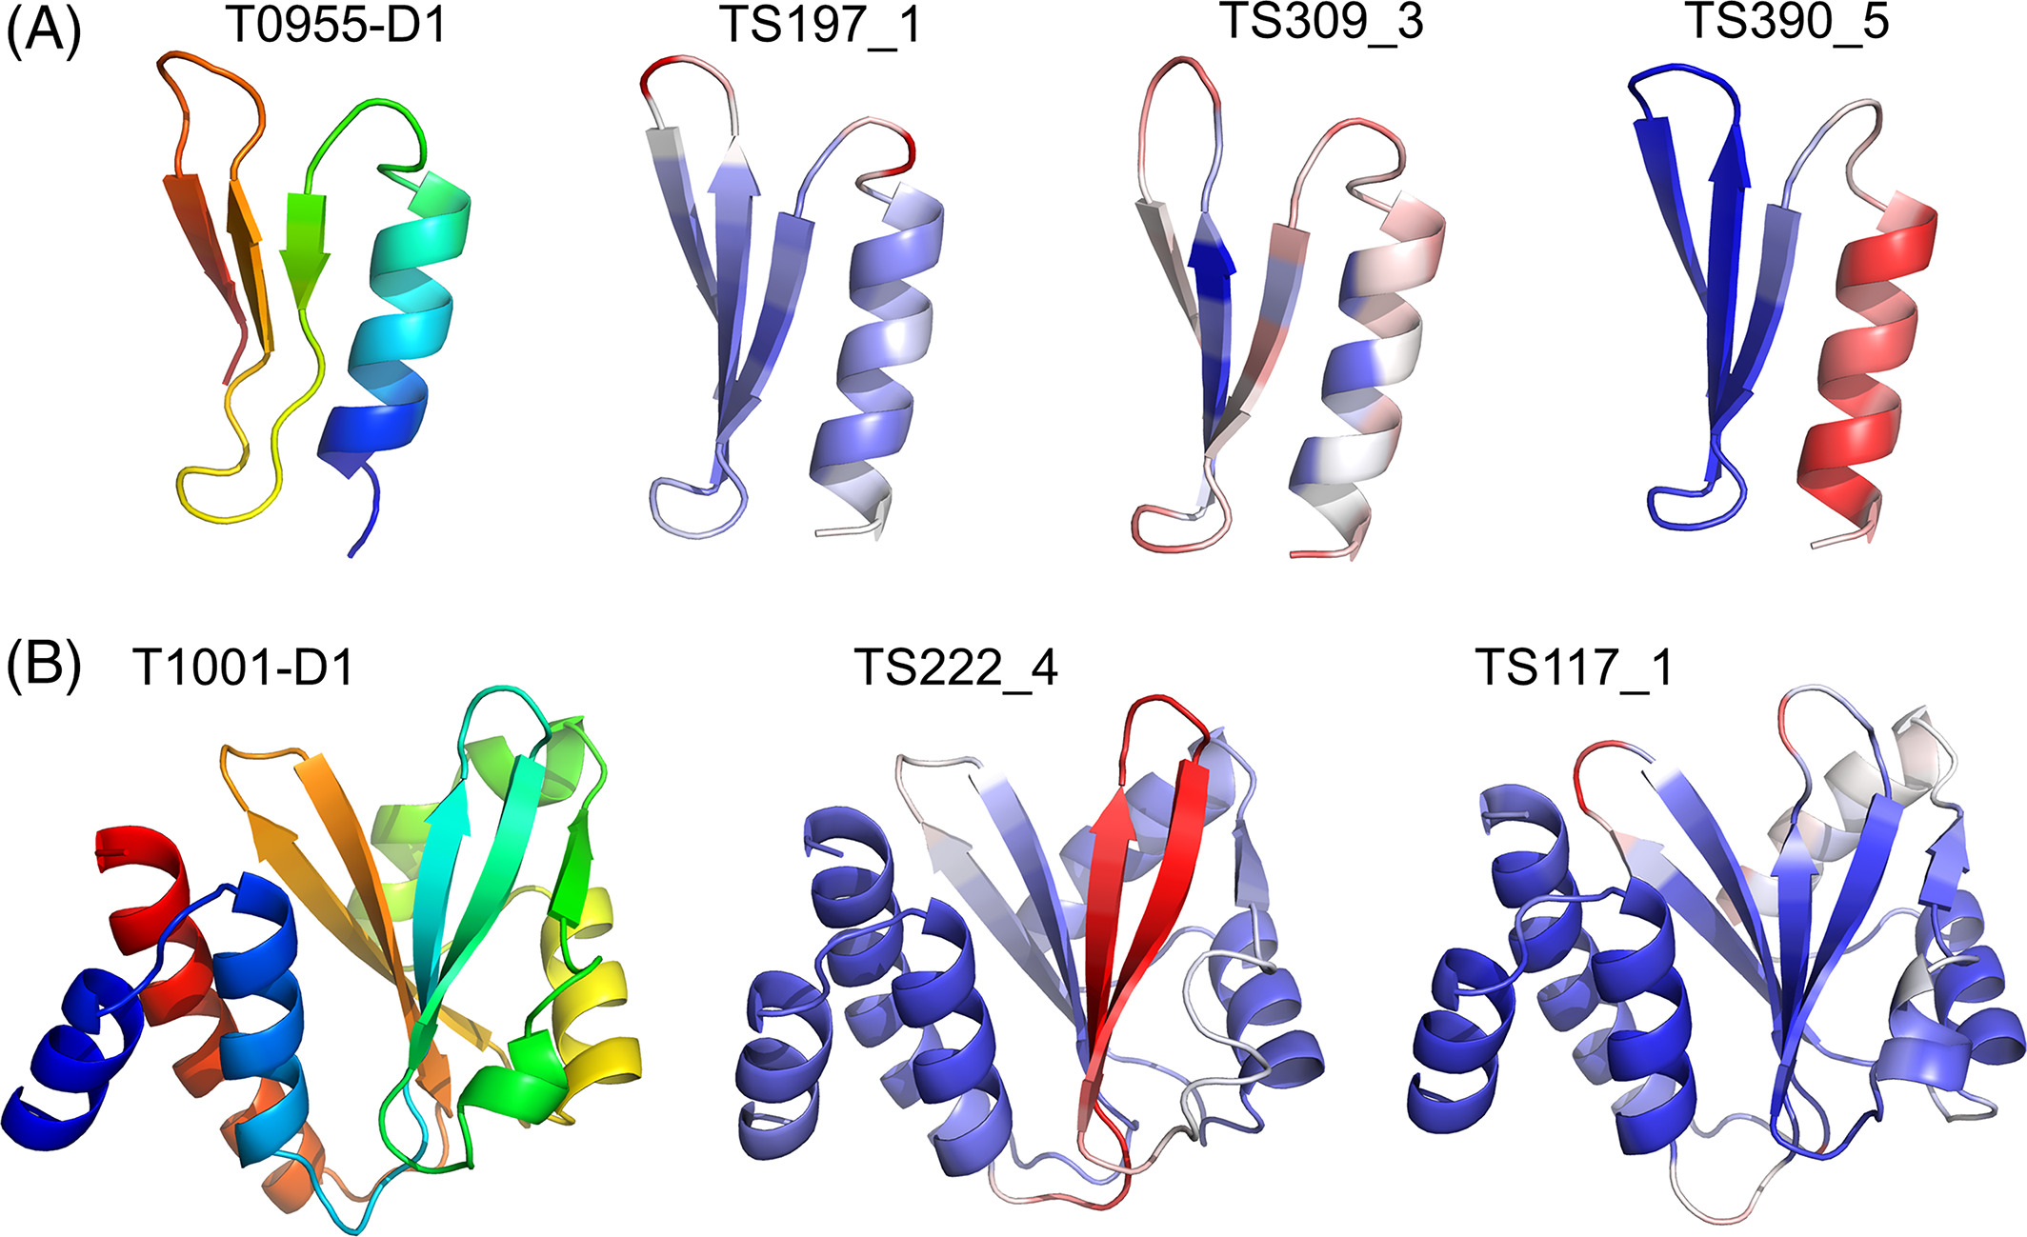
CASP13 prompts new routes for future assessments –already relevant in CASP14 & 15 !!
Time to drop splitting into EUs and assess whole structures only
Move on to harsher analyses focused on finer details: local details such as packing and side-chain conformations
Assessing not only the models but also predictions of quality estimates:
CASP14: One of AlphaFold2’s main strengths!
Abriata, Tamo, Dal Peraro, Proteins 2019 (official CASP13 assessment)
https://onlinelibrary.wiley.com/doi/10.1002/prot.25787

Slide 10
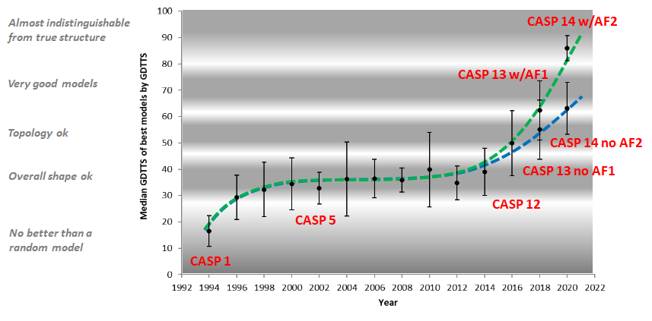
In CASP14 we could truly acknowledge that Deepmind
did beat the academic groups by far

Slide 11
How does AlphaFold 2 work?
Of course I don’t get it in full
(Deepmind’s paper in Nature actually presents elements that are new even to the people working broadly on machine learning),
So I keep this short and focused in comparing AF2 to what the others are doing so far (including AF1)…
…only stressing a couple of very practical points.

Slide 12
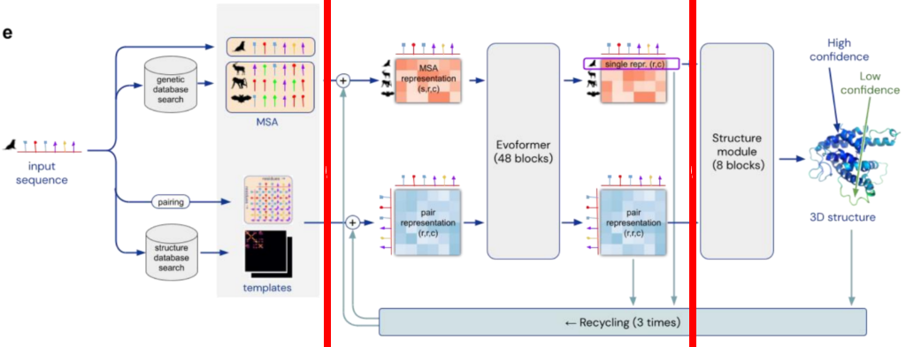
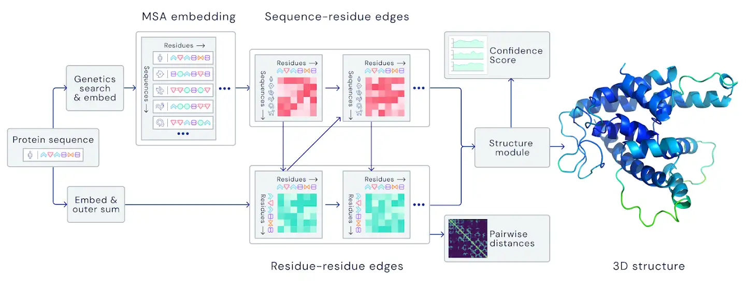
* Builds an MSA and detects templates, extracts the information from them using a neural network
- no explicit coevolution calculations
- the MSA is cleaned and paired internally –so far the AF2 is the ONLY one doing this!
… and then passes that information to another neural network that produces the 3D model
- no folding as in AF1 or every other structure predictor… the network itself builds the 3D model.
* The model works iteratively. After generating a structure, it will take all the information (i.e. MSA representation, pair representation and predicted structure) and pass it back to the beginning of the Evoformer blocks, the second part of our diagram
* The network outputs not only 3D models but also confidence predictions (more later)
* Network is end-to-end differentiable, which is important for spin off applications like design.
More in original paper and in https://www.blopig.com/blog/2021/07/alphafold-2-is-here-whats-behind-the-structure-prediction-miracle/

Slide 13
How to use AlphaFold 2
(have you used it already?)
Download 2.2 TB https://github.com/deepmind/alphafold and install everything + get a Good GPU.
Or …

Slide 14


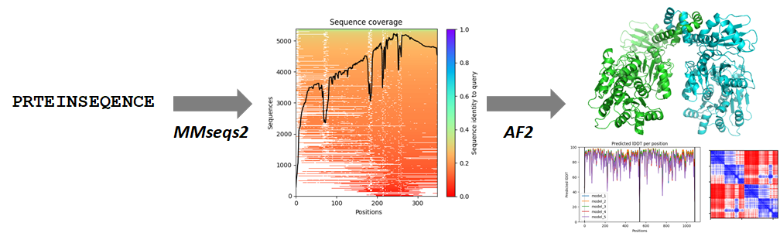
Using AF2 in the era of online programming tools
Not just AF2, but also an efficient MSA builder, MMseqs2
No need to download tons of sequences (as in AF2) because you call MMseqs2 from a server
https://github.com/sokrypton/ColabFold
https://www.biorxiv.org/content/10.1101/2021.08.15.456425v1.full.pdf

Slide 15
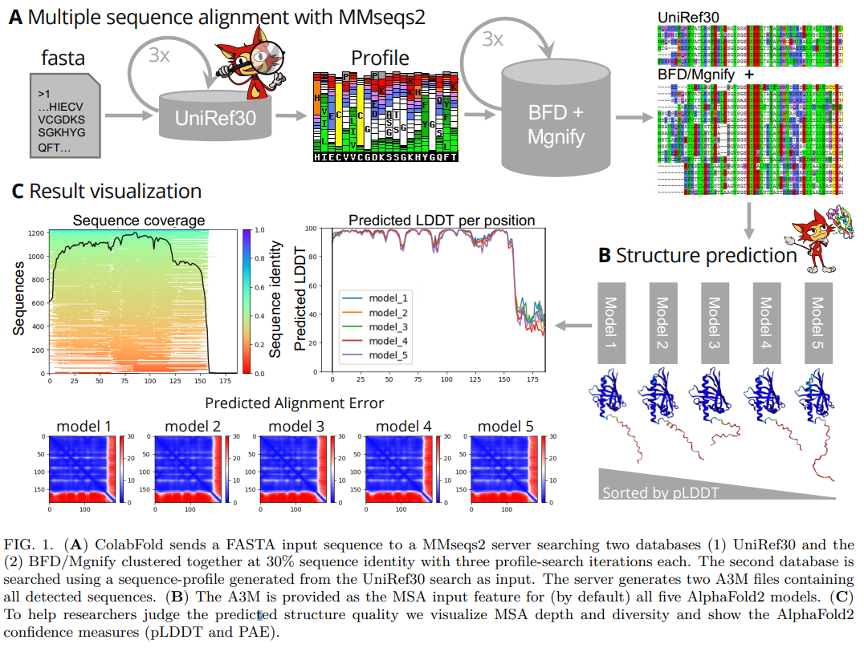
MMseqs2 at Nature Biotechnology: https://www.nature.com/articles/nbt.3988

Slide 16
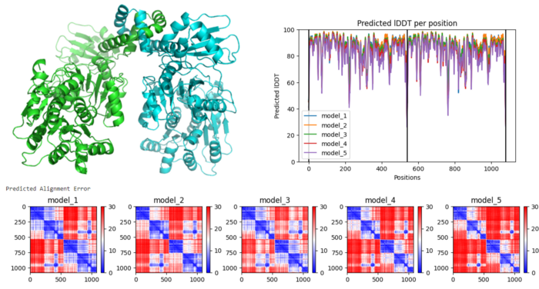
Using AF2 in the era of online programming tools
Global TM estimation
pLDDT
PAE
Complete with global, residue-wise and
residue-residue quality estimates!
And even in-colab relaxation with MD

Slide 17
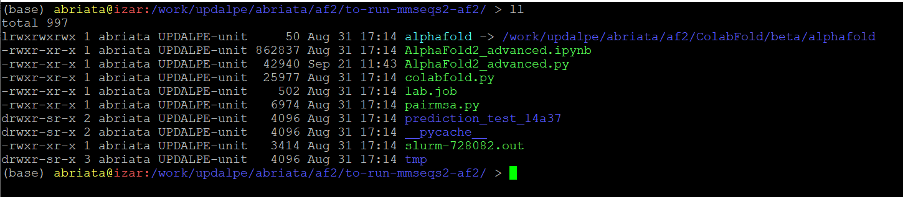
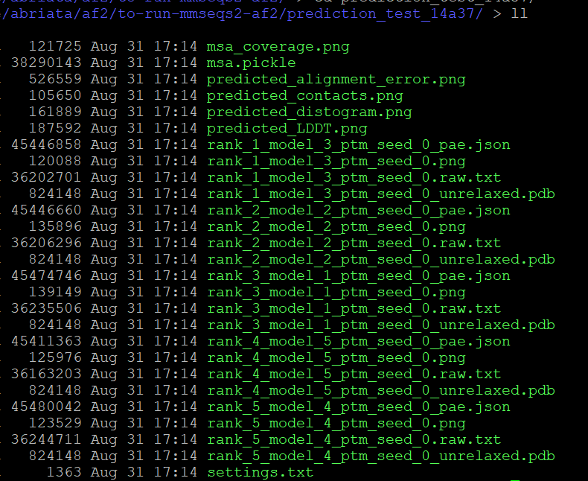
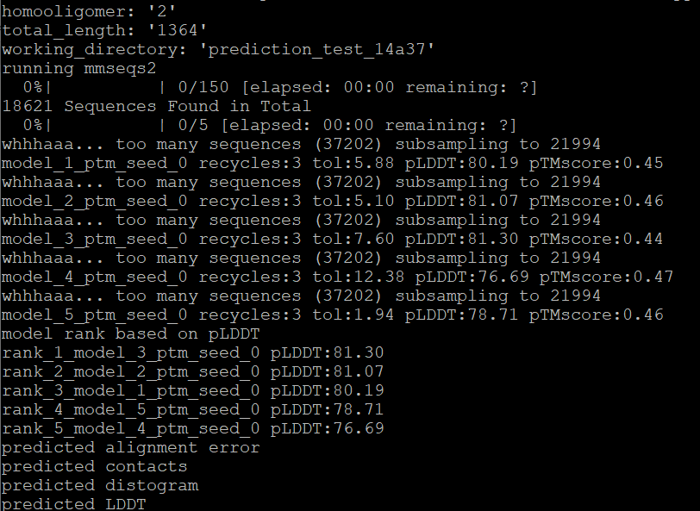
Using MMseqs2 - AlphaFold2 on EPFL’s Izar High Perf Computer
Thanks Lucien @ Dal Peraro lab for the installation
GPUs with more memory → Bigger proteins
Practically infinite time for jobs

Slide 18
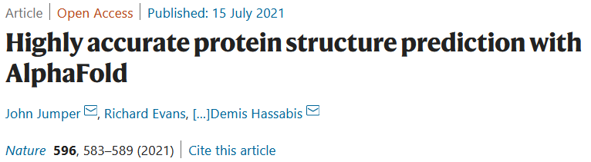
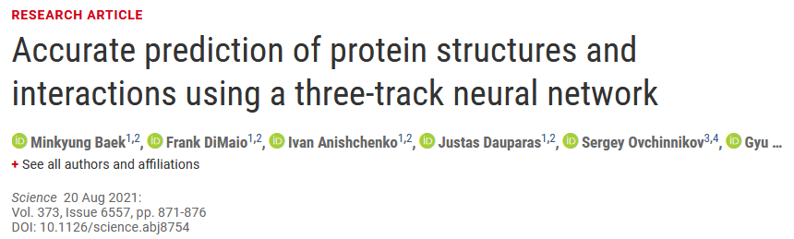
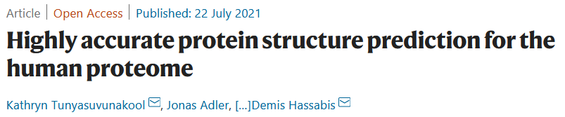
A crazy summer in 2022
Deepmind’s AF2
RosettaFold, Baker’s response to AF2
(1 day ahead, but not tested in CASP!)
Deepmind-EBI database of AF2 models

Slide 19
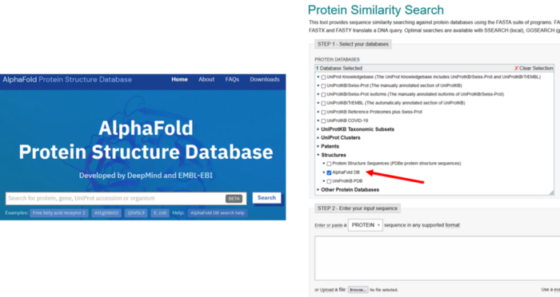
EBI-Deepmind
This means around 200 million structural models for proteins from several species.
https://www.ebi.ac.uk/Tools/sss/fasta/
https://alphafold.ebi.ac.uk/
-- Models now integrated into UniProt --

Slide 20
AlphaFold 2’s limitations + hints + coming up next
Check 0D (TM score), 1D (pLDDT), and 2D (PAE) scores
Careful with oligo states,
especially in the database which assumes monomers
Disorder ok only for short segments
Templates: good if you have them, but they also skew predictions heavily (alt conf, binding sites, etc.)
BUT:
New database by Baker lab specific for eukaryotic multimers
New AlphaFold from Deepmind tuned for P-P interactions
pLDDT best-ever predictor of disorder
No templates? Large sequence alignments compensate
https://towardsdatascience.com/alphafold-based-databases-and-fully-fledged-easy-to-use-alphafold-interfaces-poised-to-baf865c6d75e → go to “Pushing the limits:…”

Slide 21
The next slides present interesting papers +
blog entries referring you to more papers
July 15, 2021: AlphaFold2 paper in Nature + source code at GitHub + basic Colab by Deepmind
July 18, 2021: MMSeqs2 + AlphaFold in ColabFold on Twitter
July 21, 2021: https://towardsdatascience.com/google-colab-notebooks-are-already-running-deepminds-alphafold-v-2-92b4531ec127
August 15, 2021: MMSeqs2 + AlphaFold / RoseTTAFold preprint in bioRxiv:
https://www.biorxiv.org/content/10.1101/2021.08.15.456425v1
August 18, 2021: https://towardsdatascience.com/the-hype-on-alphafold-keeps-growing-with-this-new-preprint-a8c1f21d15c8

Slide 22
Additional applications beyond modeling itself (initially anecdotal, then papers came out)
Prediction of protein complexes
Prediction of disordered regions
Easily modeling inside cryo-EM (follow Tristan Croll)
Correcting models from cryo-EM (Tristan Croll)
Models for molecular replacement (already for some time in CASP, but many in CASP14)
Structure search on the models (DALI, FoldSeek)

Slide 23
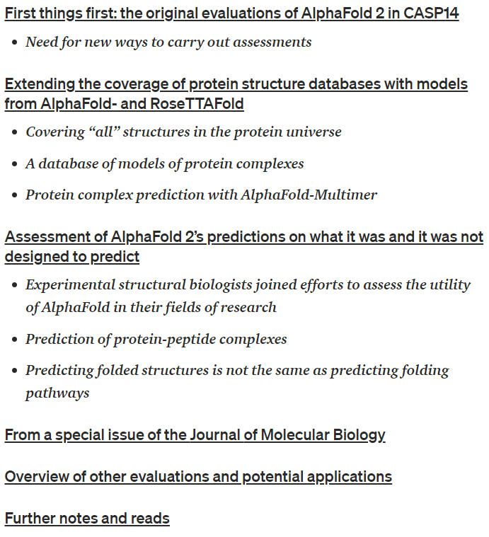
AlphaFold 2 spin-offs three months after its official release
https://towardsdatascience.com/alphafold-2-spin-offs-three-months-after-its-official-release-90c2d8714757
(EBI-AlphaFold)
(Baker lab using AlphaFold + RoseTTAFold)
(New from Deepmind)
Especially https://www.biorxiv.org/content/10.1101/2021.09.26.461876v1
Let’s say things as they are
Opinions on ML in biology
Some more examples and evaluations on AF2

Slide 24
AlphaFold 2 spin-offs three months after its official release
https://towardsdatascience.com/alphafold-2-spin-offs-three-months-after-its-official-release-90c2d8714757
Experimental structural biologists joined efforts to assess the utility of AlphaFold in their fields of research
% of proteome covered with structural data (experimental structures + homology models + AF2 models).
In particular for human proteome: 50% covered with structural data, and 20% is just long disordered segments or fully disordered proteins.
Using pLDDT as disorder predictor works better than any ad hoc disorder predictor.
Examples of using models for molecular replacement in X-ray structure resolution and direct use for modeling in cryo-EM.
Some models good enough for applications that need high resolution, such as ligand design.
EBI-AlphaFold keeps growing. The goal is to cover all UniProt.
Baker lab: AF2 + RoseTTAFold models spanning almost all key processes in Eukaryotic cells for 104 protein assemblies which have not been previously identified, and 608 which have not been structurally characterized.

Slide 25
Some more general conclusions
New tools for protein modeling pose a real advancement for biology,
but be careful of limitations
Easier advances thanks to online programming
New ways to communicate science:
Twitter for rapid spread. Deepmind even CITES tweets!
Preprinting for rapid dissemination
Reviewed blogging for rapid outreach (Medium)
Advances go too fast for traditional publishing
Role of regular publications? New ways to peer review?

Slide 26
What’s up for modeling next?
Quaternary structures not yet great
Alternative conformations
Bias towards the PDB?
Few sequences to build alignments?
New ideas and methods coming up! https://www.cameo3d.org/

Slide 27
UPDATES AS OF CASP15 (and from CAMEO)
CASP15, CAMEO, etc.
https://towardsdatascience.com/whats-up-after-alphafold-on-ml-for-structural-biology-7bb9758925b8

Slide 28
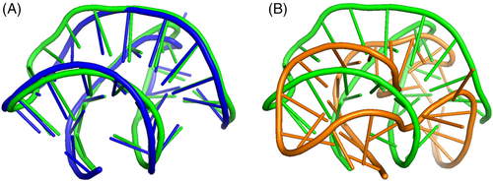
New prediction categories in CASP15
https://onlinelibrary.wiley.com/doi/10.1002/prot.26515
* RNA structure
* ligand-protein complexes BiSyRMSD and lDDT-PLI
* accuracy of oligomeric structures and their interfaces
* ensembles of alternative conformations molecule in single condition
(intrinsic dynamics) vs. conformations induced
by conditions, ligands, PTMs, pH crystal,
mutation, etc.
To split or not to split: CASP15 targets and their processing into tertiary structure evaluation units
The bar is slightly higher than in CASP13-14, of course,
and there’s higher tendency to not split (yet there are quite some splits)
> 1/3 of CASP15 EUs were attributed to the historically most challenging FM class… still difficult proteins around!

Slide 29

The Impact of AI-Based Modeling on the Accuracy of Protein Assembly Prediction: Insights from CASP15
https://pubmed.ncbi.nlm.nih.gov/37503072/
* Impressive success rate of 90%
* Most AF2 ! The trick is on what each group could add
* 1/3 of models were better than a “baseline” AF2-Multimer predictor
* And at least 1 good model for 90% of targets vs. only 54% for baseline
* Main improvements from:
- Custom-built MSAs
- Better AF2 sampling
- Manual assembly of subcomplexes
* Especially noticeable at domain and subunit interfaces
* Challenges:
- Weak evolutionary signals (nanobody-target, antibody-antigen, viral complexes).
- Very large complexes that don’t fit in memory!
+2 interesting take-aways from the conclusions
AlphaLink incorporates experimental distances obtained from cross-linking mass spectrometry to guide AF2M-based complex formation.
RoseTTAFold2 coming up! (supp. better & simpler… preprint in biorxiv & already usable in colabfold)
AF2-v2.3.0 -improved predictions for some of the hardest cases
Improving protein structure prediction with extended sequence similarity searches and deep-learning-based refinement in CASP15
https://onlinelibrary.wiley.com/doi/10.1002/prot.26551
Oda Toshiyuki
Improved protein structure prediction with trRosettaX2, AlphaFold2, and optimized MSAs in CASP15
https://onlinelibrary.wiley.com/doi/full/10.1002/prot.26570
“We first designed an elaborate pipeline that leverages complementary sequence databases and advanced database searching algorithms to generate high-quality multiple sequence alignments (MSAs).”
“I used additional tools and databases to collect evolutionarily related sequences and introduced a deep-learning-based model in the refinement step. In addition to these modifications, manual interventions were performed to address various tasks.”

Slide 30
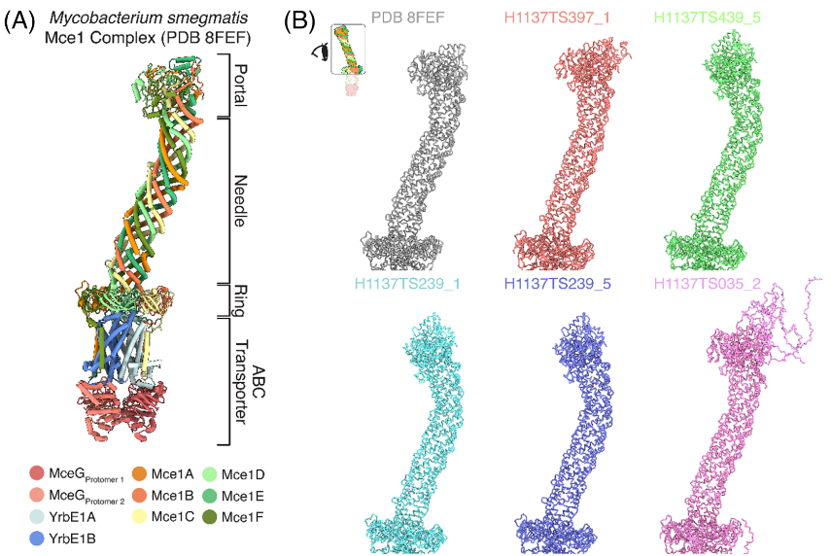
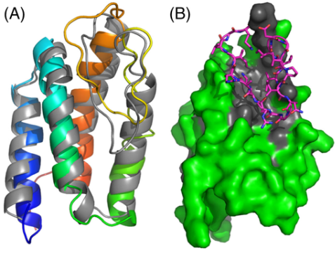
Problems in unusual features such as cis-peptide bonds, point mutations with substantial effects, atypical stoichiometries, unexpected topological exchanges, capturing very specific & key interactions hard even in good models
Mammalian Cell Entry protein, quite different to existing structures. 10 subunits w/different copy numbers.
Top models reproduce shape, stoichiometry, and many contacts. Local RMSD from 4 to 9 Angstrom in the best superpositions.

Slide 31
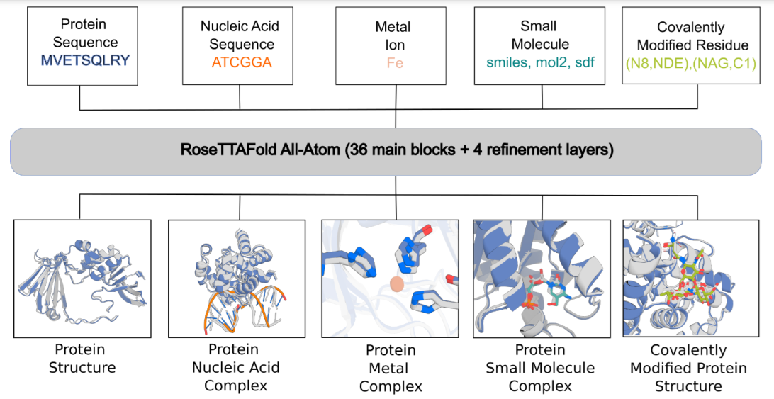
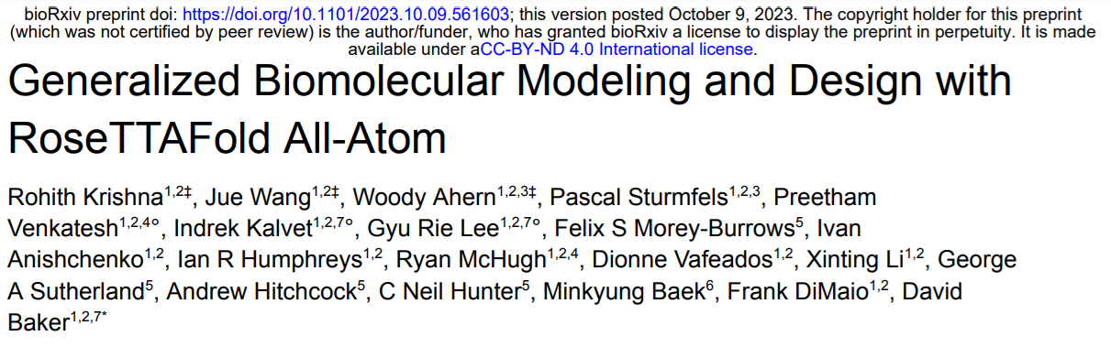
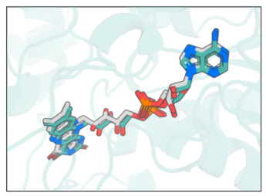
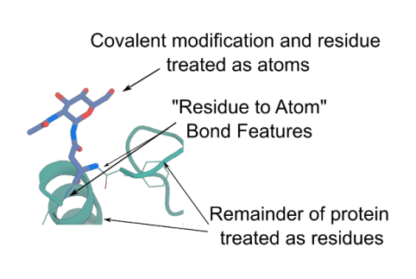
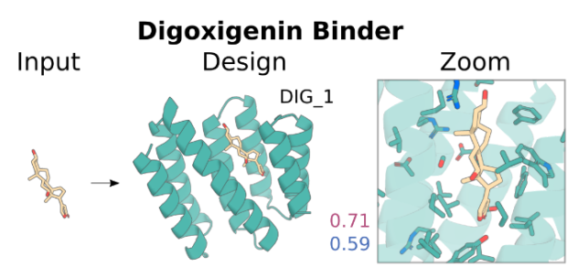
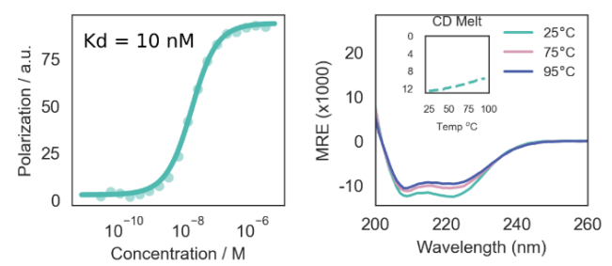
And it keeps going….
RosettaFold-All atoms
https://pub.towardsai.net/new-ai-method-for-protein-structure-prediction-handles-all-kinds-of-biologically-relevant-molecules-46e4dc2352a1

Slide 32
PART 2 FOR TODAY:
What to look at in models/sequences, and how to see more than just atoms in space/AA letters?
→ Automated analyses on models/sequences + Mapping data + Other important points

Slide 33
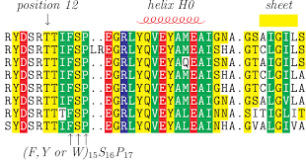
Analysis of sequences and alignments
Annotations specific for the sequence, and for families (UniProt, PFAM)
Disorder prediction
Bibliography (PubMed, Alerts, text mining)
Known domains:
BlastPDB, PFAM, UniProt, Hhpred, SwissModel
Conservation vs. variability (k*=1-20)
Linear properties like secondary structure propensity, solvent exposure, hydrophobicity, TM helices, beta barrels
All kinds of specific predictions such as signal peptides and other localization signals, MORFs, etc. etc.

Slide 34
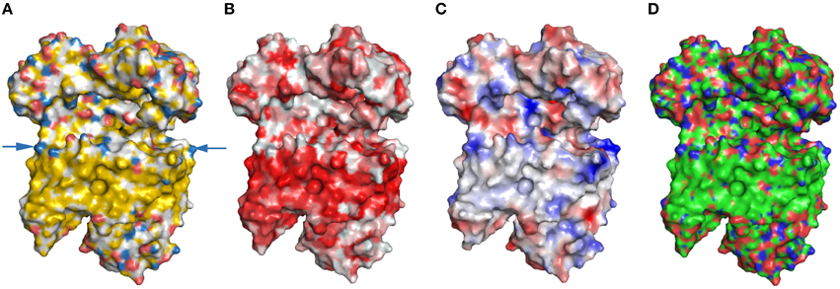
Analysis of 3D models
Visualization
(PyMOL, VMD, Chimera, JSmol, etc.)
Mapping information and predictions (literature, your own data, NMR or MS mapping, conservation, properties, etc.). Use B-factors for residue-wise data, lines or contact maps for residue-residue data
Annotations for sequence and family (UniProt, PFAM)
Model dynamics from quantum to classical atomistic to classical big chunks
Detect motifs and domains, for ex. DALI, FoldSeek
Find (cryptic) pockets, alt. conformations, binding sites (docking, manual/autom. analyses)
Define soluble vs. (trans/peripheral) membrane regions
Surface properties like electrostatics (see PDB2PQR and APBS websites)
Modeling homologous proteins, mutations, etc.
Analyze primary data (B-factors, electronic densities, NOEs, chemical shifts…)
Details well supported?
Compare structures: PyMol et al ok for very similar sequences, otherwise use a sequence-independent program like https://zhanglab.ccmb.med.umich.edu/TM-align/
Ex. https://www.frontiersin.org/articles/10.3389/fmolb.2015.00056/full

Slide 35
What to look at in models?
* EMDB, PDB, BMRB sites
* Specific to each technique; probably best with an expert
Primary data supporting a structure
Need (expert with) experience and good computer control,
but you can still do a lot even not being expert –next classes
Modeling and simulations

Slide 36
What to look at in 3D structures / models?
* Data from literature and your experiments
* PROPKA, PDB2PQR, APBS (electrostatics) [online here]
* Mapping all kinds of NMR data onto structures [online tool here]
* Mapping crosslinks and peptides from MS (for ex. HDX-MS) [online tool here]
* Mapping interactions (for ex from antibodies directed against epitopes of a subject protein)
* Transmembrane regions –OPM [here]
* Domains known at the sequence and/or structure levels (UniProt, PFAM, ECOD, etc…)
* Binding sites for ligands, ions, etc. Seek (cryptic) pockets (various tools like FPocket)
* Color residue-wise data by B-factor, link pairs of residues with lines or use contact maps [online tool here]
* Check crystallographic waters (visual)
* Amino acid variability + tolerance to substitution (build alignment and go here)
* Evolutionary rates
* Pairs of co-evolving residues or residues predicted to be in contact
…
Mapping information and predictions

Slide 37
What to look at in 3D structures / models?
* Several PDB-derived databases specifically for TM proteins (check this graph)
* Ad hoc predictions for TM helices & TM beta barrels, from sequence of by running coarse-grained simulations
* How do polar and hydrophobic residues distribute in the sequence and model or structure? (visual analysis)
* For transmembrane proteins, pay attention to:
- Hydrophobic regions of soluble elements may be confused with TM regions
- Reentrant helices
- Amphipathic helices
- Pro introduces kinks, often functional
- Hydrophobic match/mismatch: membrane can modulate protein orientation, but protein can also affect local membrane thickness. Protein can also partition into specific lipid rafts (ex. Spike)
- Beta barrels in outer membranes
- Expected patterns: hydrophobic residues outside, polar inside except for interactions, aromatic right under lipid polar heads
…
Define soluble vs. transmembrane and peripheral membrane-interacting regions

Slide 38
What to look at in models?
* Small-molecule docking (a whole discipline in itself; programs out there not trivial; need expertise)
* Virtual Screening (same as above)
* Analysis of binding pockets (some automated tools + a lot of visualization; MD often helps)
* Prediction of protein-X binding interfaces (PESTO, adMaSIF, both @EPFL)
* Protein-protein/NA/etc. docking (HADDOCK among the best, and see CAPRI)
* Membrane insertion (OPM-like or CG simulations)
Docking
* FoldSeek or DALI: search a structure, domain or motif in the PDB
* 2D projections like PCA
* RMSF between models (easy in VMD) of related models, for ex. from an NMR ensemble, from simulation, or from different X-ray structures (see CoDNaS)
* Align function in PyMOL (sequence-dependent)
* TM-align and similar programs (seq-independent)
Comparing structures

Slide 39
Students: * Visit a PDB site or one of its related sites * Get to a PDB entry and try to find its source data and the related paper/s. (Alternatively, begin by a paper and go look for the relevant PDB entries). * View the model on your computer. What program is best, esp. considering the data? * Are all structural details well supported by the data? Does it matter for this or that application? (More to be developed throughout the course)
Hands-on (leftover from class 1 that will keep showing up)

Slide 40
Students: * Pick a protein of your interest for which you have a structural problem that cannot be answered with any PDB entry as it is. * Explore sequence with various tools (disorder prediction, MoRFs, TM helices/barrels, secondary structures, PFAM/UniProt annotations, etc.) * Search sequence in the PDB (BLAST, HHpred, SwissModel, etc.) * Can you model by homology? Would you rather try AlphaFold2? Run modeling. * Inspect the various models you got and all the associated metrics. Are the predicted structural details well supported? Does it matter for your original question?
Hands-on for class 2

